Slide 1
Теория Информации
В.Н. Ярмолик
Лекция 16
2017

Slide 2
Physical Cryptography Main definitions
Physical cryptography is a different and very recent approach to cryptography and security which is based on inherent complexity of nanoscale electronic and photonic systems.
R. Pappu, B. Recht, J. Taylor, N. Gershenfeld, Physical One-Way Functions, Science, vol. 297, pp. 2026-2030, 20 September 2002.
The main category belongs to physical cryptography is Physical Unclonable Function (PUF), which firstly have been call as Physical One-Way Function (POWF), Physical Random Functions (PRF). While the two last terms have been coined first, today mainly the expression Physical Uncloneable Function or PUF is in use. The notion of a Physical One-Way Function has been defined by R. Pappu. It definitely owns the merit of being the first formalization attempt in the field. One of the widely used now definition of PUFs has been proposed by Tuyls et al.

Slide 3
Physical Cryptography Main definitions
Definition 1. Physical Unclonable Function consist of inherently unclonable physical systems. They inherit their unclonability from the fact that they consist of many random components that are present in the manufacturing process and can not be controlled. When a stimulus is applied to the system, it reacts with a response. Such a pair of a stimulus (challenge) C and a response R is called a challenge-response pair (CRP). In particular, a PUF is considered as a function that maps challenges to responses.
According to this definition Physical Unclonable Functions or PUFs have been introduced as challenge response entities that are undetachably embedded in a physical system, possibly a silicon integrated circuit. The physical system is, explicitly or implicitly, produced in such a way that it contains uncontrollable random elements.

Slide 4
Physical Cryptography Main definitions
More general definition of PUFs as Super High Information Content systems (SHICs) have been made by U.Ruhrmair.
Definition 2. Physical Unclonable Functions is the complex disordered physical systems with extraordinarily high amount of structural information which satisfy to the next conditions:
1. The information content of the system can be extracted reliably and repeatedly through measurement with different challenge C_{i} and obtaining the resulting response (answer) R_{i}.
2. The number of possible challenges C is so large that the values of all corresponding responses R cannot be determined for all possible challenges C, within limited time.
3. Due to high information content in the system it must also be impossible to model, computationally learn, simulate or otherwise numerically predict the challenge-response pair (C_{j},R_{j}) based on known pair (C_{l},R_{k}).
4. It must be prohibitively difficult to physically reproduce or clone PUF as physical systems.

Slide 5
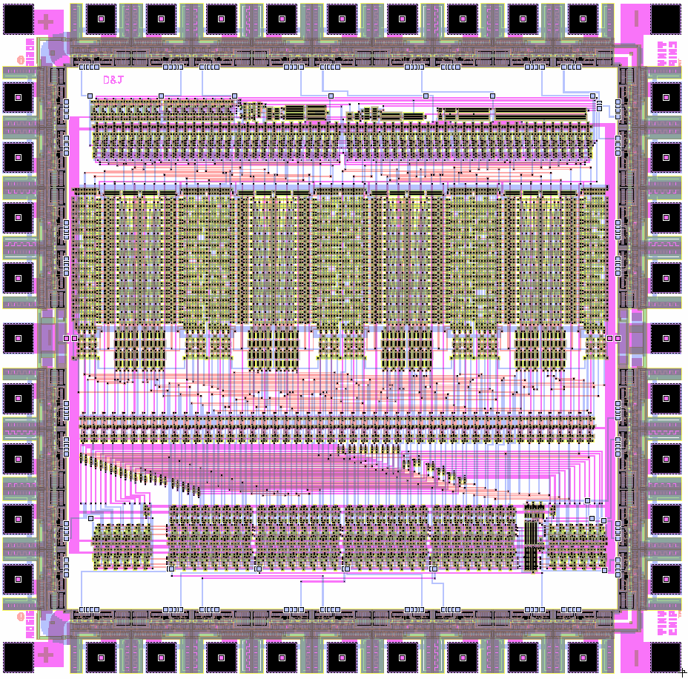
Physical Cryptography PUF’s main properties
Physical Unclonable Function (PUF) [Pappu, Gassend et al 2002]
PUF Security is based on
  wire delays
  gate delays
  quantum mechanical fluctuations
PUF characteristics
  uniqueness
  reliability
  unpredictability
PUF Assumptions
  Infeasible to accurately model PUF
  Pair-wise PUF output-collision probability is constant
  Physical tampering will modify PUF

Slide 6

Physical Cryptography Delay-Based Silicon PUF concept
Because of random process variations, no two Integrated Circuits even with the same layouts are identical
  Variation is inherent in fabrication process
  Hard to remove or predict
  Relative variation increases as the fabrication process advances
Delay-Based Silicon PUF concept
  Generate secret keys from unique delay characteristics
  of each processor chip
Challenge
Response
Combinatorial Circuit

Slide 7
Physical Cryptography PUF for IC
PUF implementations for silicon integrated circuits
The first PUFs embedded in silicon devices that were suggested are based on delay measurements of digital paths. Because of process variations, two identically designed digital paths on two ICs, or on two distinct places on the same IC, will not have exactly the same delay from their input to their output. Very well known method have been proposed to measure the random delay variations have been call as Arbiter PUF.
Arbiter PUFs
According to Arbiter PUF a race condition is introduced by feeding two symmetrical paths into an arbiter. Two simultaneous pulses on the inputs of the paths will in general not arrive at the outputs simultaneously due to small random delay variations. The arbiter decides which of the two paths was the fastest.

Slide 8
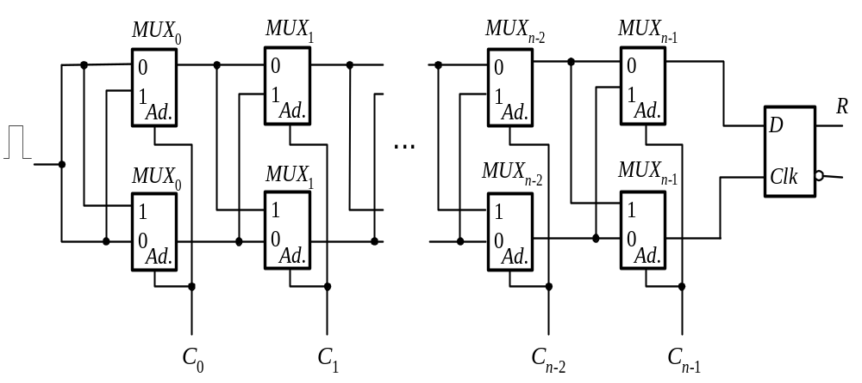
Physical Cryptography MUX based Arbiter PUF
The challenge bits C determine the delay paths by controlling the MUXes. To evaluate the response R for a particular challenge C, a rising signal is given to the inputs of both paths at the same time, the signals race through the two delay paths, and the arbiter (D-latch) at the end of two paths decides which signal is faster.

Slide 9
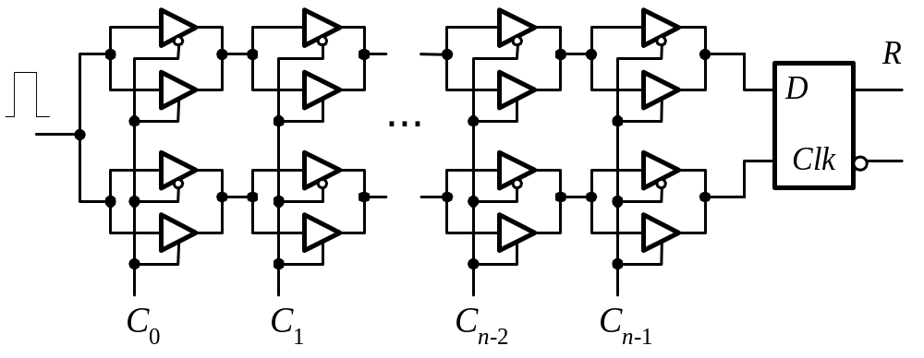
Physical Cryptography Tristate Buffers PUF
The proposed PUF circuit is utilizing the delay variances of tristate buffer. In this case the tristate buffers just replaced MUXes of original Arbiter PUF presented in previous slide. The simulation results presented in show that the Tristate Buffer based PUF consumes less power and requires less area overhead compare to the MUX based version.

Slide 10
Physical Cryptography MUX based Arbiter PUF
The MUX-based one-output (m=1) Arbiter PUF circuit with n=64 stages (64-bit challenge C) has been fabricated and tested in TSMC’s 0.18μm, single-poly, 6-level metal process. The experimental results show that two identical PUF circuits with identical challenges C on two different chips have different responses R with a probability of 23% (interchip variation). For ideal PUFs with pure symmetric layout for the circuit shown in Figures 1 and 2 the interchip variation would be close to 50%. Within the same framework, multiple measurements on the same chip showed that responses R were different with the probability equals to 0.7% (intrachip variation). For ideal PUFs this probability should be equal 0.0%, what means that the values of responses R have to be constant and can be extracted reliably and repeatedly through measurement for all possible challenges C.

Slide 11
Physical Cryptography Ring Oscillator PUFs
Ring Oscillator PUFs
This type of PUFs is based on ring oscillators (delay loops). Each ring oscillator (RO) is a simple circuit with odd number of invertors with feedback loop that due to manufacturing variation oscillates with a particular frequency.
&
&
&
0/1
1
1
Ring Oscillator

Slide 12
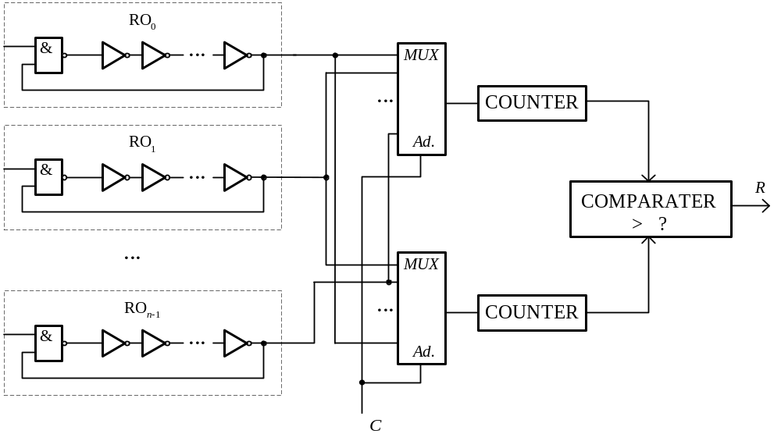
Physical Cryptography Ring Oscillator PUFs

Slide 13
Physical Cryptography Ring Oscillator PUFs
In a case of RO PUF presented in last slide each comparison of a pair of RO generates one bit response R. For n RO there are n(n − 1)/2 distinct pairs of RO. As have been shown the response bits obtained from pair-wise comparisons are correlated. For example, if oscillator RO_{i} is faster than oscillator RO_{j}, the comparison will yield R=1. If RO_{j} is in turn faster than RO_{r}, the comparison will yield R=1. It is clear that when RO_{i} is compared with RO_{r} that the comparison will be same R=1 - these bits are correlated. Fortunately, it is possible to derive the maximum entropy of this circuit assuming pair-wise comparisons, i.e., the number of independent bits that can be generated by the circuit as a function of n, the number of RO. There are n! different orderings of ring oscillators based on their frequencies. In a case when the orderings are equally likely, the entropy will be log₂(n!) bits. For example, 128 oscillators can produce 716 bits.

Slide 14
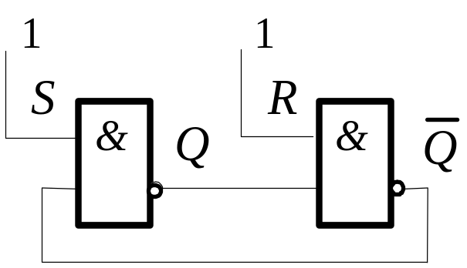
Physical Cryptography SRAM based PUF
SRAM based PUFs
Static Random Access Memory or SRAM is a very common type of volatile storage in integrated circuits. A typical SRAM-cell consists of six transistors in CMOS-technology. The actual storage element comprising four transistors implements two cross-coupled inverters. The cross-coupled storage element is bi-stable, meaning it has two stable states, and hence can store one bit of information by residing in one of both states. When the cell is powered on, it will quickly converge into one out of two stable states. A cross-coupled circuit is constructed such that it provides a positive feedback loop to store the required bit value within the loop. An example of such a circuit is a simple R-S latch based on two 2NAND gates is shown below.

Slide 15
Physical Cryptography SRAM based PUF
As have been shown earlier the amount of randomness present in the power-up values of the flip-flops is limited. This is due to the strong favor of most flip-flops to start up in ’0’, rather than a more or less fifty-fifty chance. The experimental investigations have been made on three different Virtex-II Pro FPGAs. The power-up values of 4096 flip-flops (32 columns × 128 rows) were measured after 101 consecutive power-ups. The result shows that more than 90% of the measured flip-flops always power-up as ’0’ versus little less than 10% which always start up as ’1’. Less than 1% will start up as ’0’ some of the times and ’1’ the other times. This results allows to make the conclusion that SRAM based PUF is not reliable, especially for FPGA implementation. To overcome this problem the concepts of the butterfly PUF which behave similarly to a SRAM cell during the startup phase have been proposed.

Slide 16
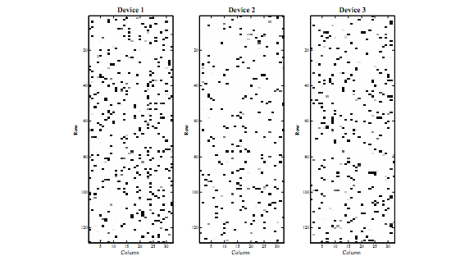
Physical Cryptography SRAM based PUF

Slide 17
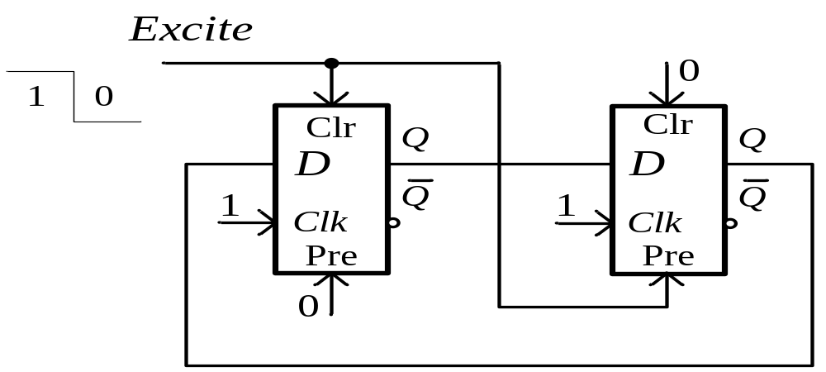
Physical Cryptography The Butterfly PUF
The Butterfly PUF, proposed by Kumar et.al, is a technique that aims to emulate the behavior of an SRAM PUF. This technique is based on the simulation of cross-coupled combinational loop using latches presented in the FPGA. The structure of the Butterfly PUF cell is constructed as symmetrically as possible.

Slide 18
Physical Cryptography The Butterfly PUF
The Butterfly PUF consists of two latches, each with a preset (Pre) and clear (Clr) inputs. In Butterfly PUF the signal at the Pre input of first latch and the signal at the Clr input for the second latch are always set to 0. The Excite input is connected to Clr of latch 1 and Pre of latch 2. The Clk signal in both latches is always high. To start the PUF operation, the Excite signal is set to high. This brings the Butterfly PUF circuit to an unstable operating point. After some period of time Excite signal is set to low. This initiates the process of the Butterfly PUF circuit to attain either one of the two possible stable states, 0 or 1 at the Q output of the second latch. The final state is determined by the random delay mismatch in the pair of feedback paths and the Excite signal paths due to process variation.

Slide 19

Physical Cryptography R-S Latch PUF
R-S Latch truth table
Current inputs
S R
Next inputs
S R
Current state
Q
Next state
Q
S R=XX
0 0
Q
1 1
S R=XX
0 1
Q
1 0
S R=XX
1 0
Q
0 1
S R≠00
1 1
Q
Q
S R=00
1 1
Q
Random value 1 0 or 0 1

Slide 20
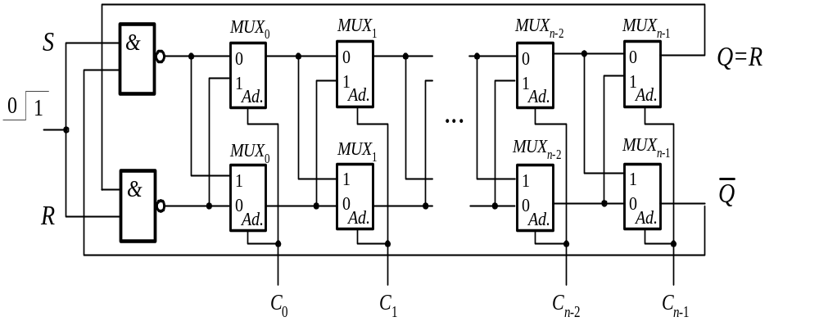
Physical Cryptography Arbiter&RS PUF
To increase the variations of random value of the delay time the combined implementation of PUF can be proposed. This solution Arbiter&RS PUF is united two approaches, namely Arbiter PUF and R-S Latch PUF, as is shown in Figure.
Figure 7. Arbiter&RS PUF

Slide 21
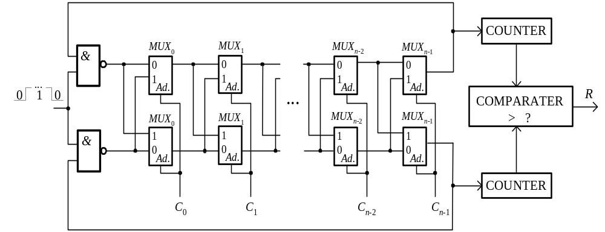
Physical Cryptography RO&Arbiter PUF

Slide 22
Physical Cryptography PUF Efficiency
Comparison of PUF With Digital Hash Functions
Algorithm
MD4
MD5
SHA-256
AES
Yuksel
PUF
# of gates
7350
8400
10868
3400
1701
545
Reference PUF: 545 gates for 64-bit input
  6 to 8 gates for each input bit
  33 gates to measure the delay
Low gate count of PUF has a cost
  probabilistic outputs
  difficult to characterize analytically
  non-unique computation
  extra back-end storage
Different attack target for adversaries
  model building rather than key discovery
Physical security
  hard to break tag and remain undetected

Slide 23
Using PUFs
Physical Cryptography PUF Application
System Identification
Intra-distance
Inter-distance
x
PUF A
y_{A}
Frequency
y_{A} ≠ y_{A}’
x
PUF A
y_{A}’
y_{A} ≠ y_{B}
x
y_{B}
Distance measure
PUF B
Optimal Identification
Threshold
FAR:
False Acceptance Rate
FRR:
False Rejection Rate

Slide 24
Physical Cryptography PUF Application
ECC PUF
In the Field:
Symmetric
Key Generation
PUF
Circuit
n
Decoding
n
Hash
k
m
Syndrome/Mask
In the field, the syndrome will be used to re-generate the same PUF reference output from the circuit
  This output is unique and unpredictable for each chip
  Can be directly used as a symmetric key

Slide 25
Physical Cryptography PUF Application
Private/Public Key Pair Generation
Private key
ECC
PUF
Seed
Key
Generation
Public key
PUF response is used as a random seed to a private/ public key generation algorithm
  No secret needs to be handled by a manufacturer
A device generates a key pair on-chip, and outputs a public key
  The public key can be endorsed at any time

Slide 26
Physical Cryptography PUF Application
Low-Cost Authentication
Protect against IC/FPGA substitution and counterfeits without using cryptographic operations
Untrusted Supply Chain / Environments
Authentic
Device A
???
Is this the
authentic
Device A?
PUF
PUF
Challenge
Response
Record
Challenge
Response’
Challenge
Response
1010 010101
1000 101101
0111001 000110
=?
Database for Device A

